Slide 1
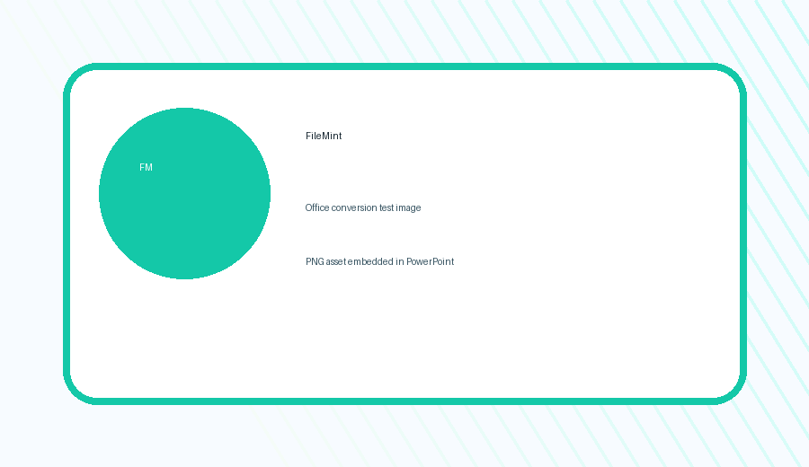
PowerPoint to PDF Test
Checks text, tables, charts, shapes, images, spacing, colors, and page layout.
Text
Tables
Charts
Images
FileMint PPTX -> PDF test deck | Slide 1

Slide 2
Editable Table Layout
# | Subject | Grade 9 | Grade 10 | Grade 11
1 | Mathematics | 5/5 | 5/5 | 9/10
2 | Russian Language | 5/5 | 5/5 | 9/10
3 | English | 4/5 | 5/5 | 8/10
4 | Computer Science | 5/5 | 5/5 | 10/10
5 | Average Grade | 4.95/5 | 4.95/5 | 9/10
Expected PDF: table borders, cell colors, alignment, and column widths should stay stable.
FileMint PPTX -> PDF test deck | Slide 2

Slide 3
Chart and Shape Fidelity
Rounded shape
Arrow connector
Shadow-like blocks
FileMint PPTX -> PDF test deck | Slide 3

Slide 4
Mixed Text and Formatting
English: This paragraph checks normal text wrapping and spacing.
???????: ???????? ????????? ? ??????????????.
??????: ??????? ??????? ?????? ??? PowerPoint.
??: ???????????
Arabic: ??????? ??????? ???? ???????.
Embedded PNG should remain crisp in PDF.
FileMint PPTX -> PDF test deck | Slide 4

Slide 5
Conversion Checklist
Slides keep 16:9 page size
Expected Output
Clean PDF
No cropped slides
Readable tables
Sharp image
Tables do not shift or stretch
Chart colors and labels remain clear
Images stay in the same position
Mixed scripts render correctly
FileMint PPTX -> PDF test deck | Slide 5

